Slide 1




Digital Study Techniques - Organize
Save time with:
Keyboard shortcuts
Organize folders and documents
Tidy "desk"
Organized browser
Organize
Focus

Slide 2

Organize folders and documents
Organize
Focus

Slide 3


Folders
Folders:
Find materials more easily
Better overview
Use different colors for the folders
Tip: For example, if you are creating a document on the subject of SCIENCE, first open the folder and then create the document. Then the document ends up right from the start.
Organize
Focus

Slide 4
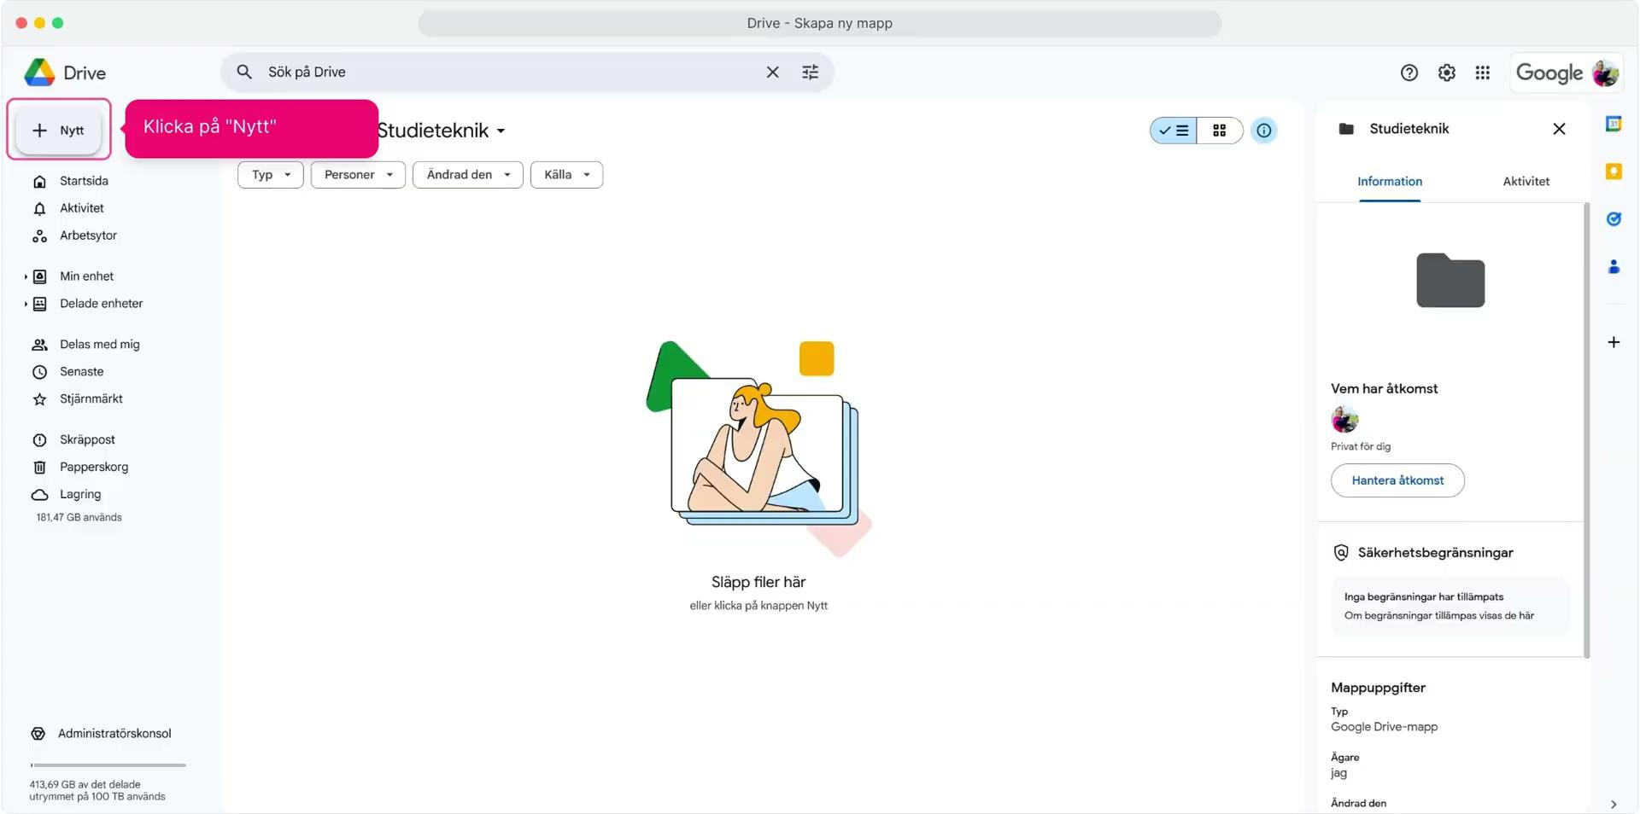
Folders - Google drive
Create new folder and change color
Organize
Focus

Slide 5
Folders - One drive
Organize
Focus

Slide 6
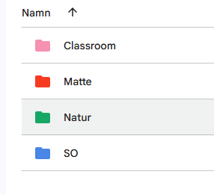
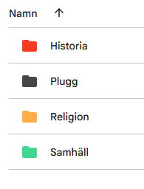
Task
Create a folder structure for your topics.
Organize
Focus

Slide 7


Organize documents
Organize
Focus

Slide 8
Organize documents
Heading levels:
Clear parts/structure
Easier to read
Table of contents:
Overview of the text
Easy to jump to the right page
Tala in text
Quickly get thoughts down to text
Organize
More manuals can be found at Organizing presentations and manuals
Focus

Slide 9
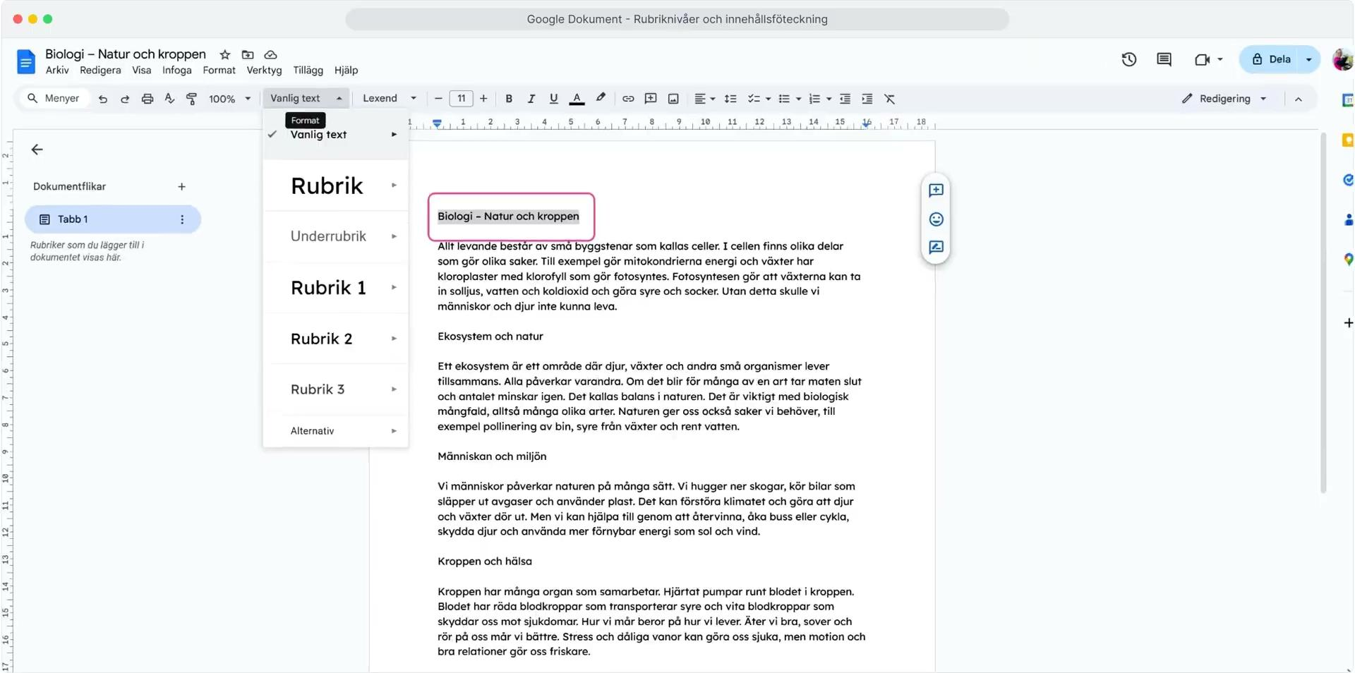
Google Docs - Heading Levels and Table of Contents
Organize
More manuals can be found at Organizing presentations and manuals
Focus

Slide 10
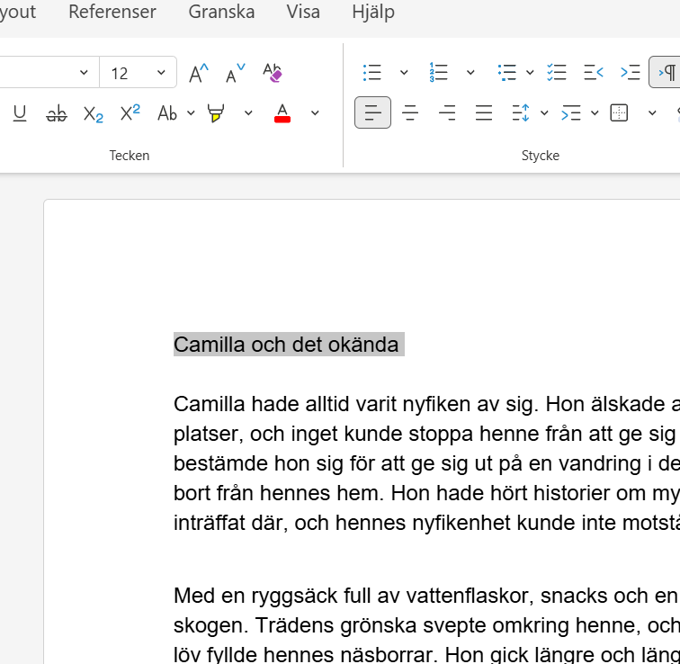
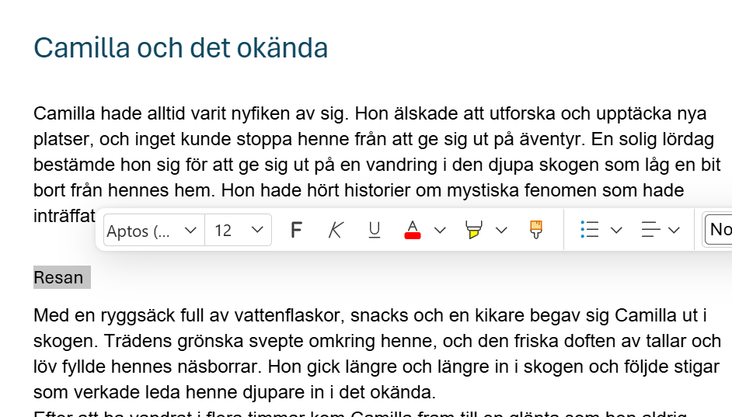
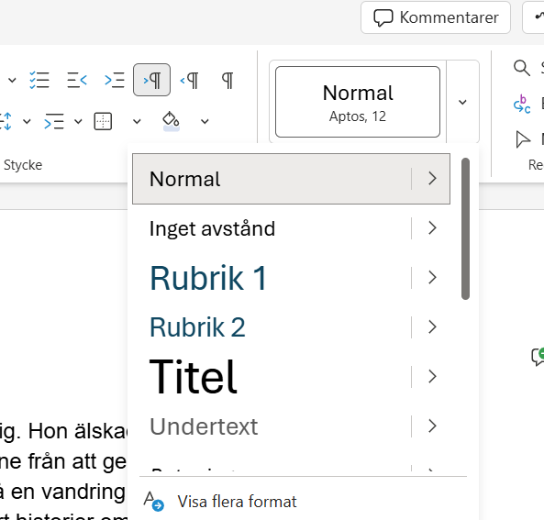
Word online - Heading levels
The text is now set as "Heading 1"
2.
Select "Format" from the menu and select Heading 1
1.
Select the text that should be the title
3.
Repeat steps 1 and 2 for other text that should be headings.
But select "Heading 2".
Organize
More manuals can be found at Organizing presentations and manuals
Focus

Slide 11
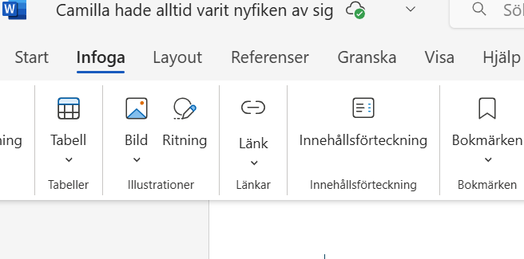
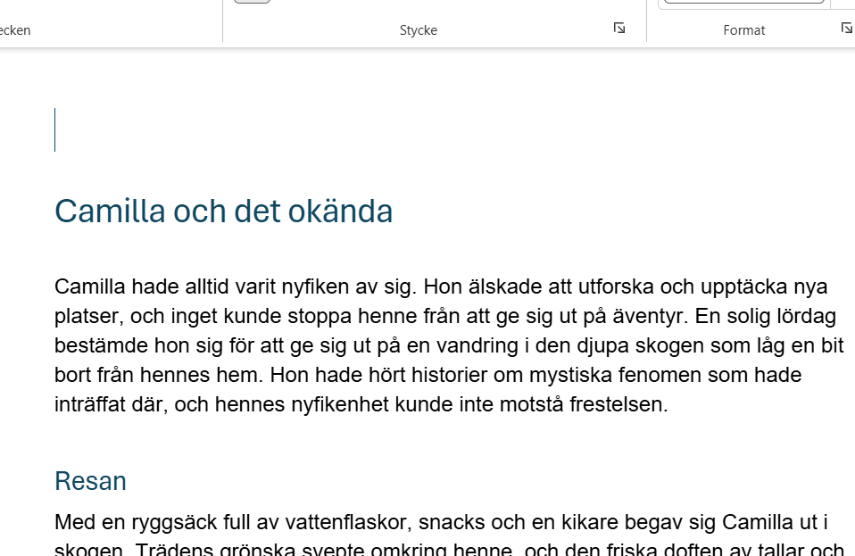
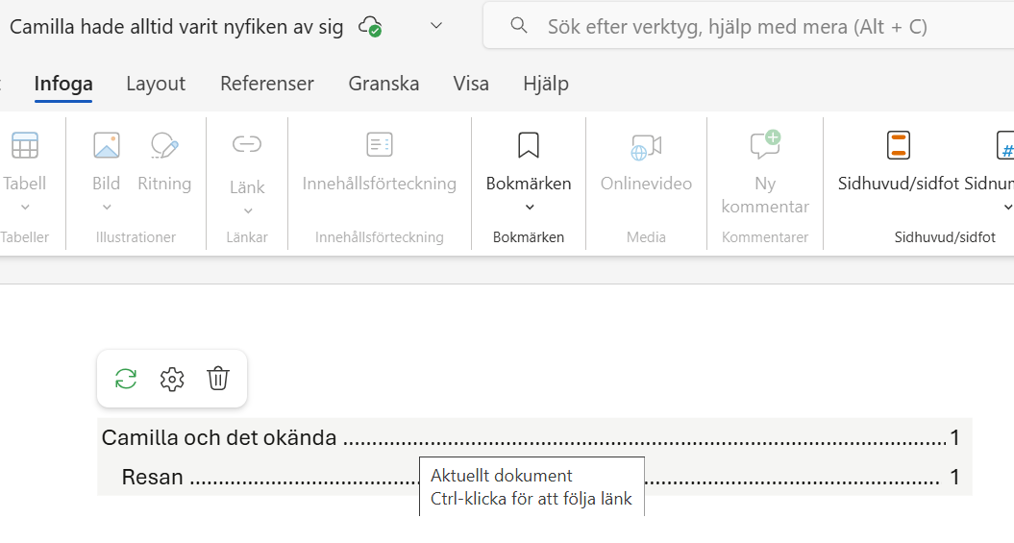
Word online - Insert Table of Contents
3.
Click on "Table of Contents"
2.
Click "Insert" in the menu.
1.
Place the cursor where you want to insert the table of contents.
Choose the appearance by hovering over the table of contents and clicking on the gear.
4.
Organize
More manuals can be found at Organizing presentations and manuals
Focus

Slide 12
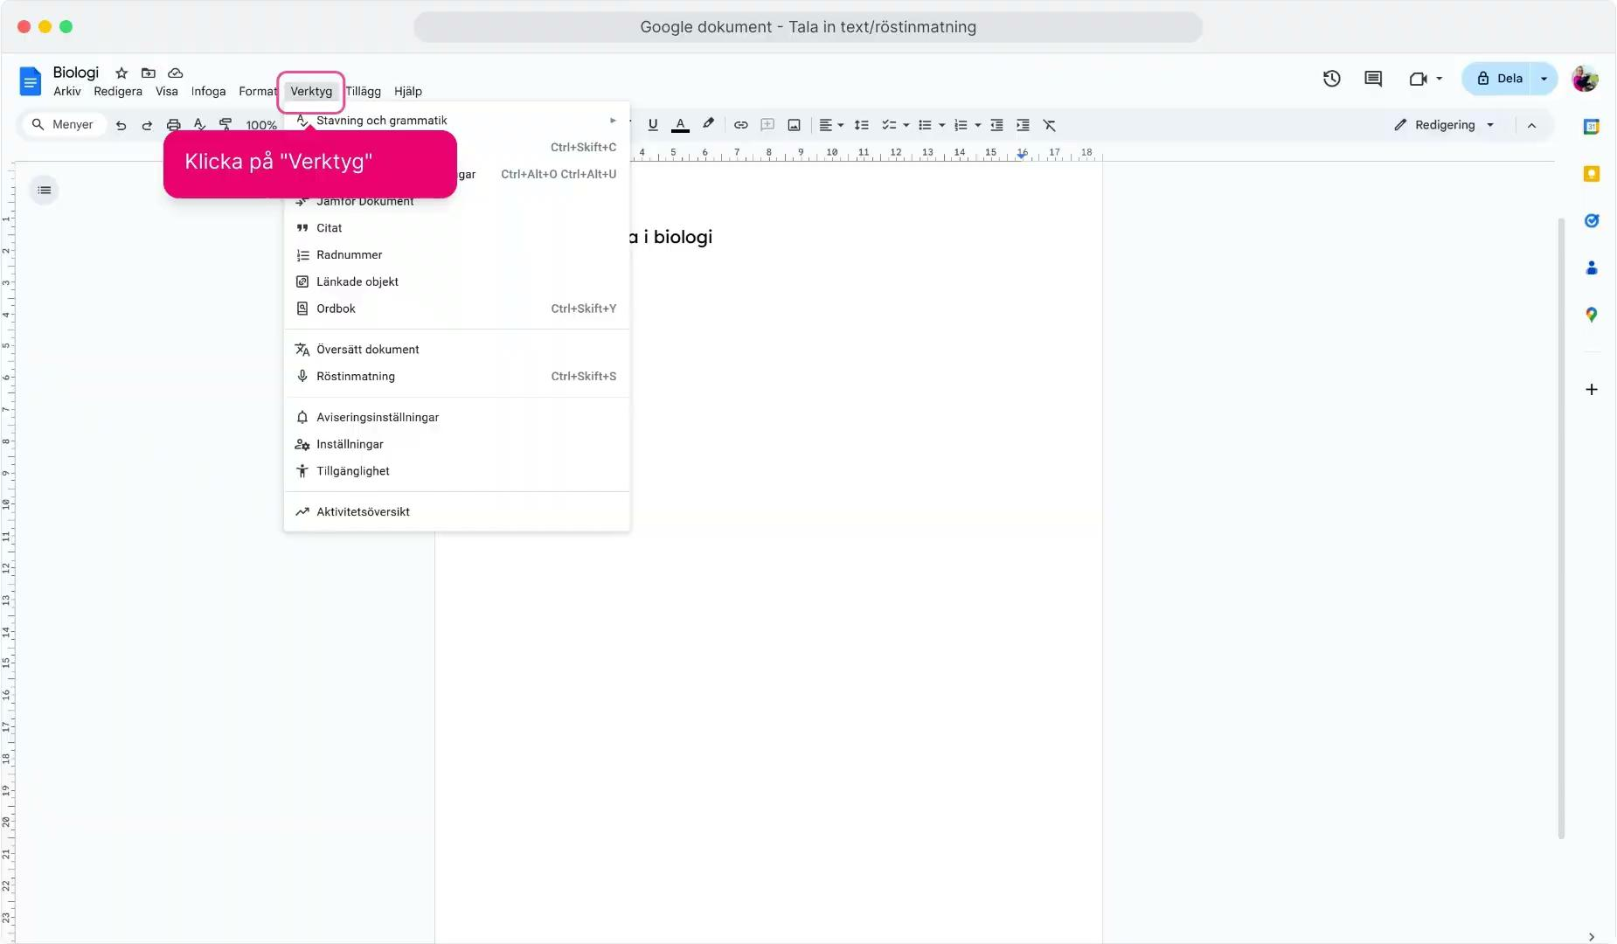
Google Docs - Voice Typing
Organize
More manuals can be found at Organizing presentations and manuals
Focus

Slide 13
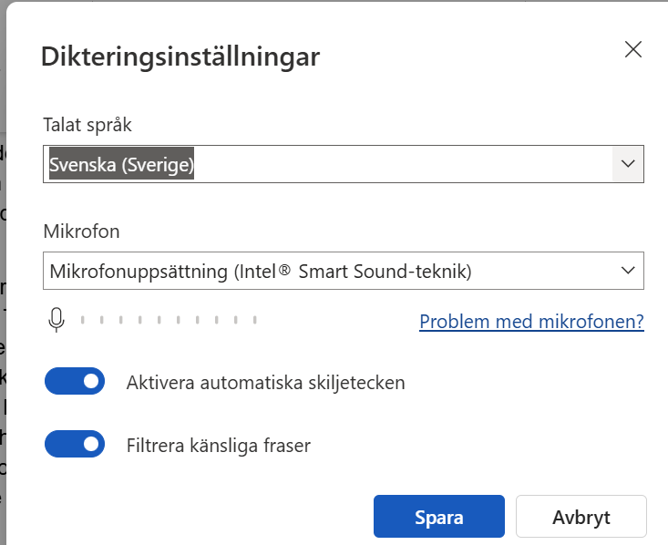
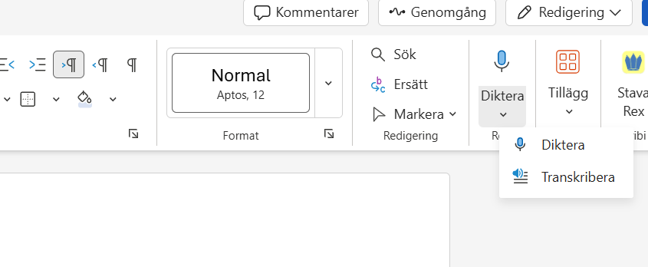

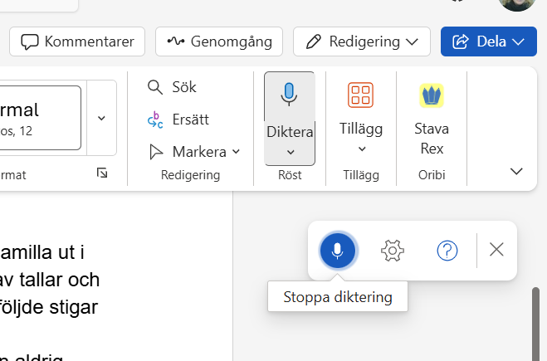
Word online - Röstinmatning
1.
2.
Click on "Dictate" in the menu.
The dictation should start right away - if it doesn't, click on the microphone.
Click on the "Gear" to change the spoken language.
3.
Click the microphone to stop recording.
Organize
More manuals can be found at Organizing presentations and manuals
Focus

Slide 14

Task
Try the voice typing feature and speak a presentation about yourself.
Organize
Focus

Slide 15


Organize your desktop
Organize
Focus

Slide 16
Organize the desktop/app launcher
Order of apps/programs
Find faster when apps are in the same place.
Save time.
Less stress – an organized screen makes the device uncluttered.
Organize
Focus

Slide 17
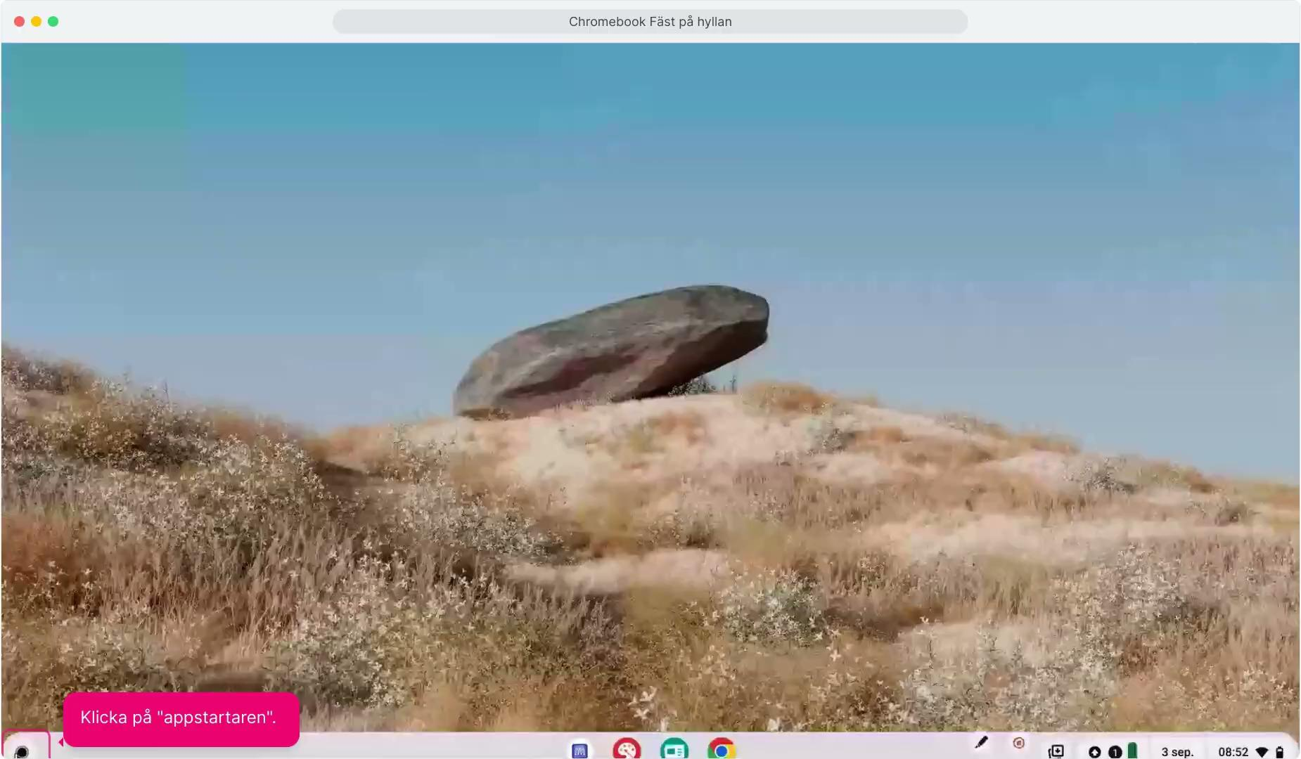
Chromebook - Sticking apps to the shelf
Organize
More manuals can be found at Organizing presentations and manuals
Focus

Slide 18
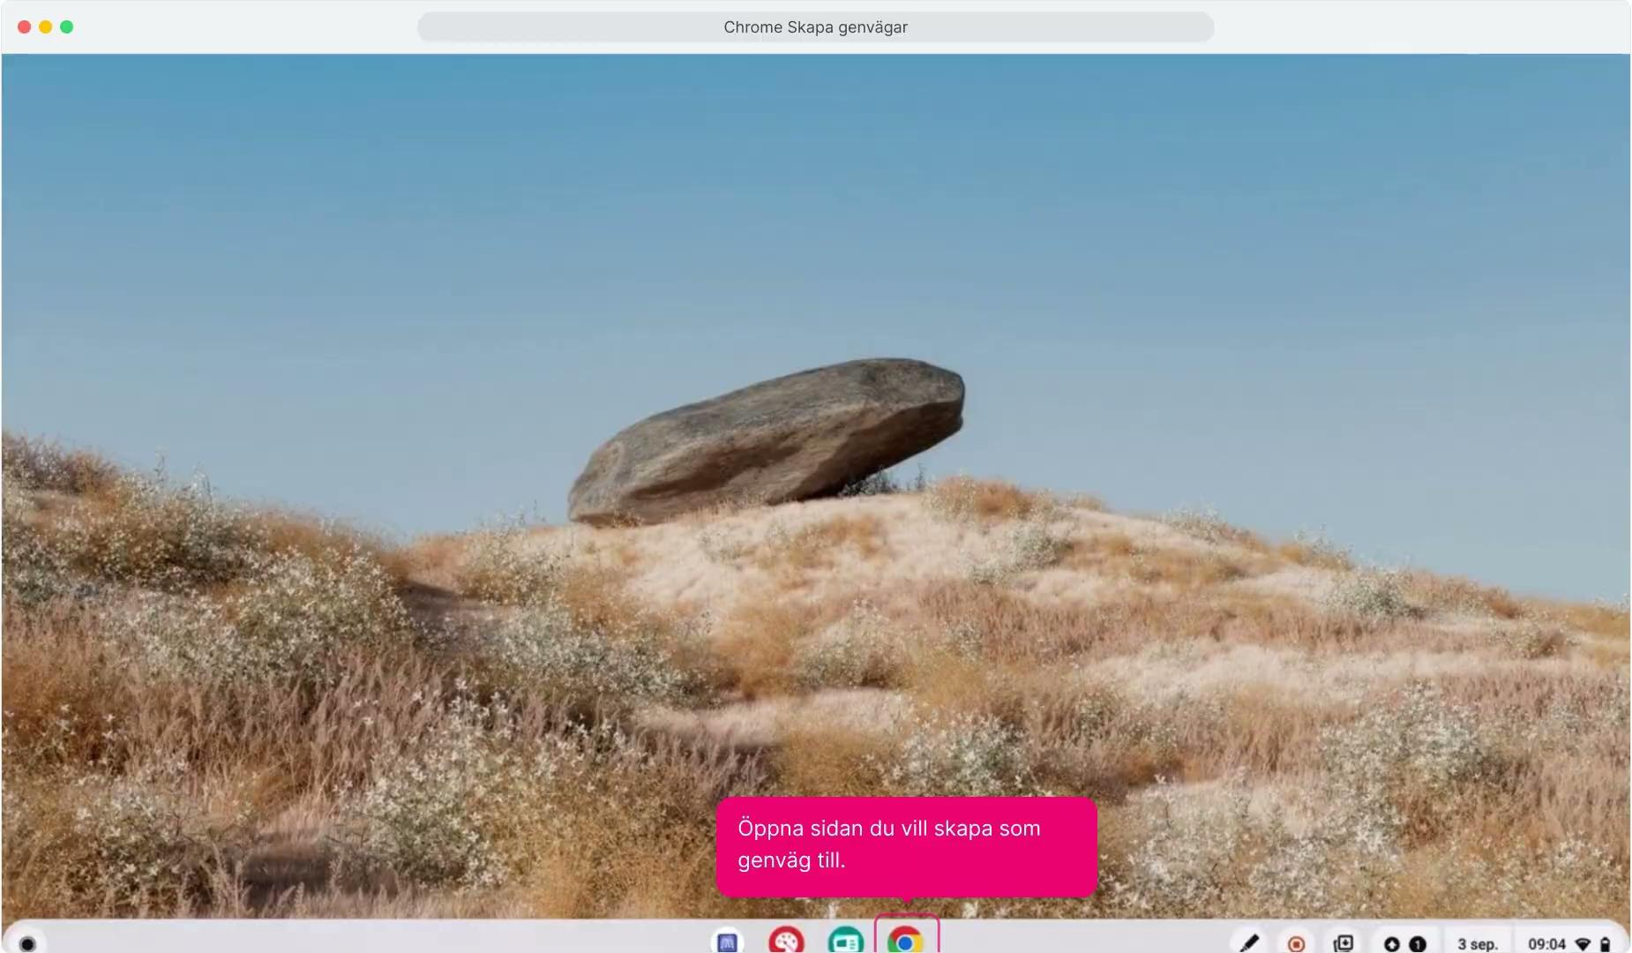
Chromebook - Adding a shortcut
Organize
More manuals can be found at Organizing presentations and manuals
Focus

Slide 19
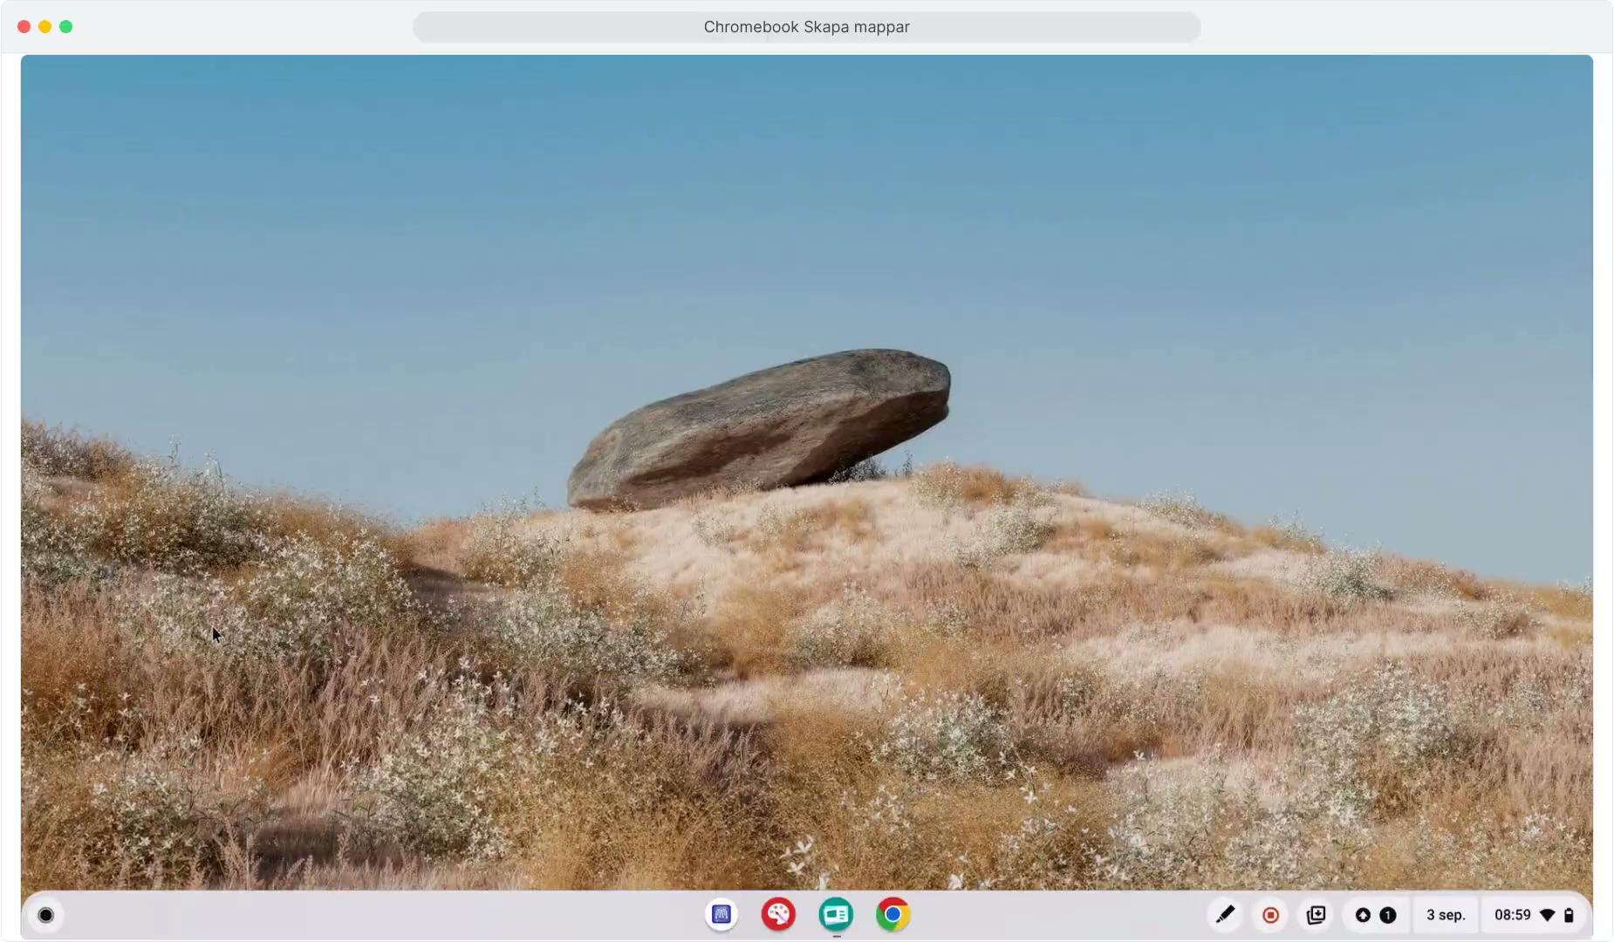
Chromebook - Putting apps in folders
Organize
More manuals can be found at Organizing presentations and manuals
Focus

Slide 20

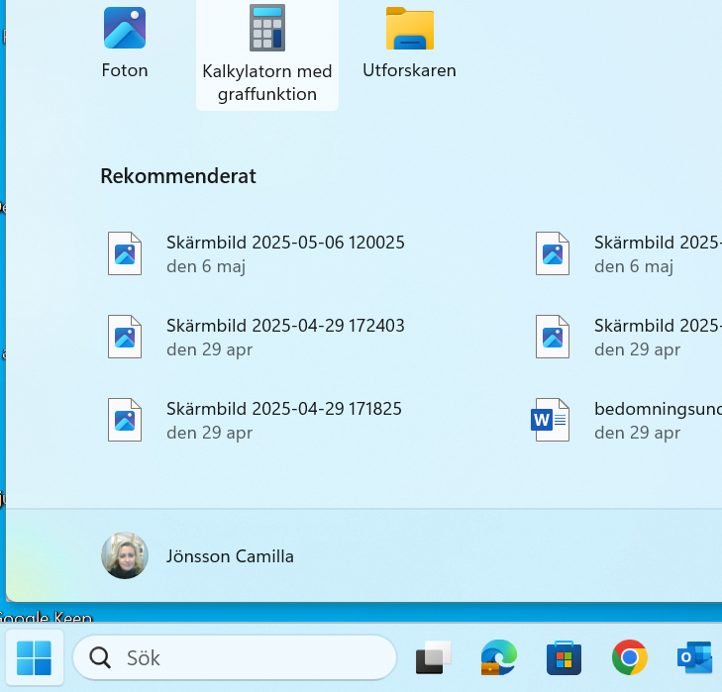
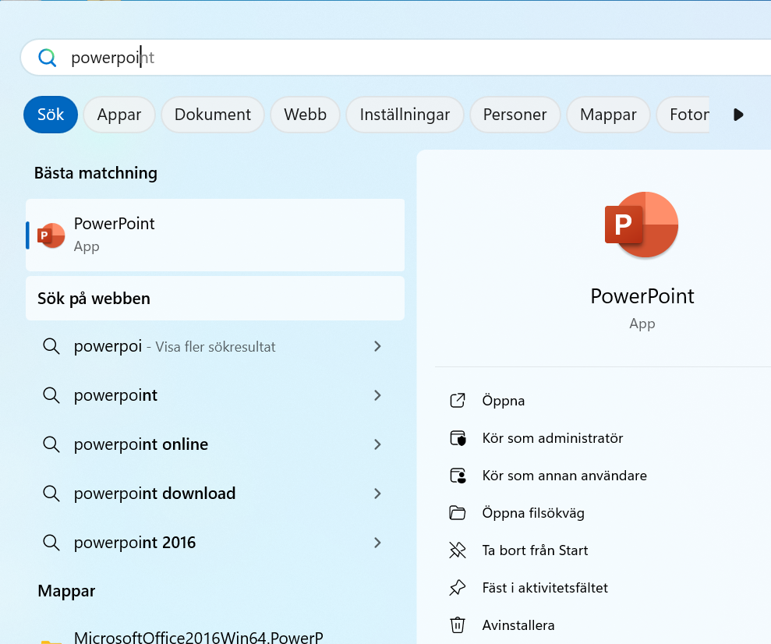
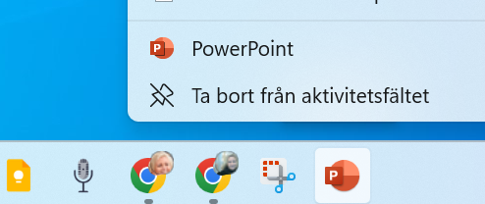
Windows 11 - Pinning apps to the taskbar
2.
Search for the app you want to pin to the taskbar.
The app will be pinned to the taskbar.
Click on the "Start Menu" (windows symbol)
You can right-click on the app and "Remove from taskbar".
1.
Click on "Pin to taskbar"
3.
Organize
More manuals can be found at Organizing presentations and manuals
Focus

Slide 21
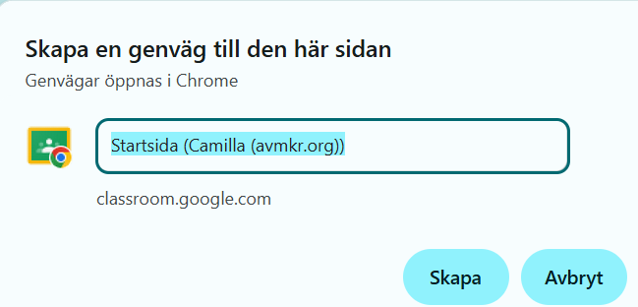
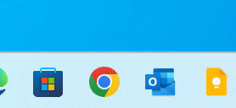
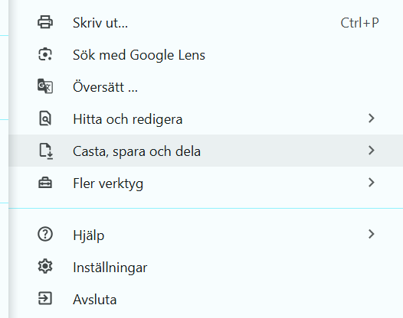
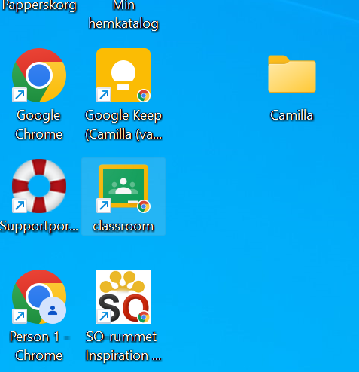
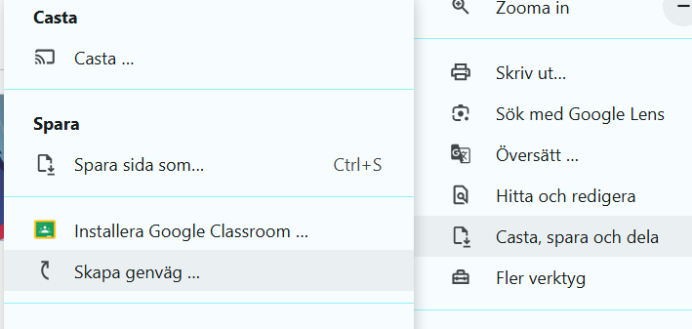
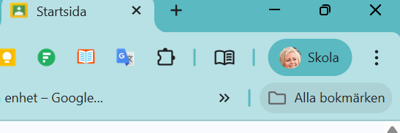
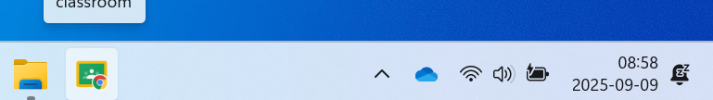
Windows 11 and Chrome - Create Shortcut
5.
You can name your shortcut and click create.
1.
Select "Cast, Save & Share".
Open a webpage in Chrome.
3.
The shortcut settles on your desktop.
Drag the shortcut to the taskbar.
Click on the three dots.
Select "Create Shortcut".
2.
4.
6.
Organize
More manuals can be found at Organizing presentations and manuals
Focus

Slide 22
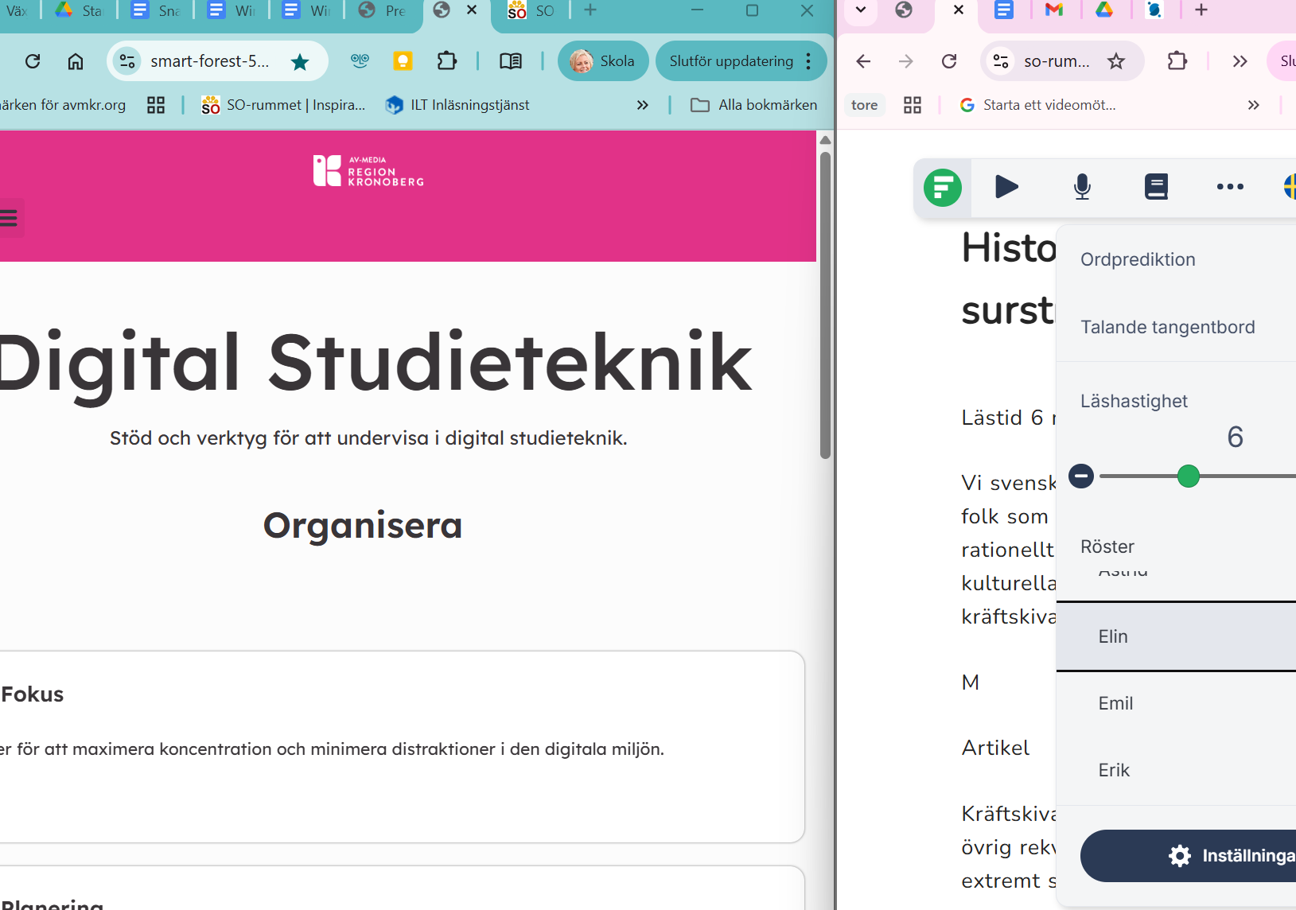
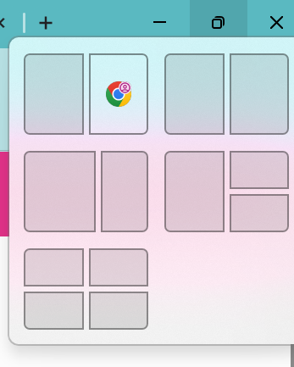
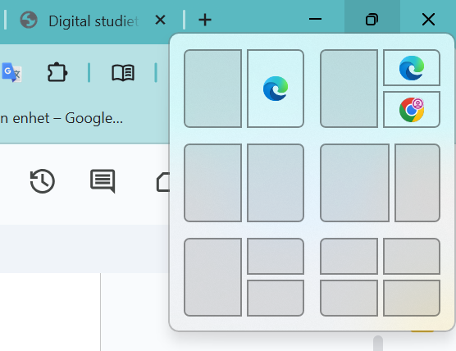
Windows 11 - Snap layouts
1.
Open a window in your browser.
3.
Choose a layout. Click the box in the layout where you want to place your window.
2.
Hold over the maximize button. Then you will get different Snap layouts.
4.
Windows will now display your other open windows. Click on a window to fill the next blank box in the layout.
Organize
More manuals can be found at Organizing presentations and manuals
Focus

Slide 23


Organize your browser
Organize
Focus

Slide 24
Organize your browser
Save bookmarks/favorites in the browser to quickly find your way back.
Tab groups/collections to keep the browser organized.
Organize
Focus

Slide 25
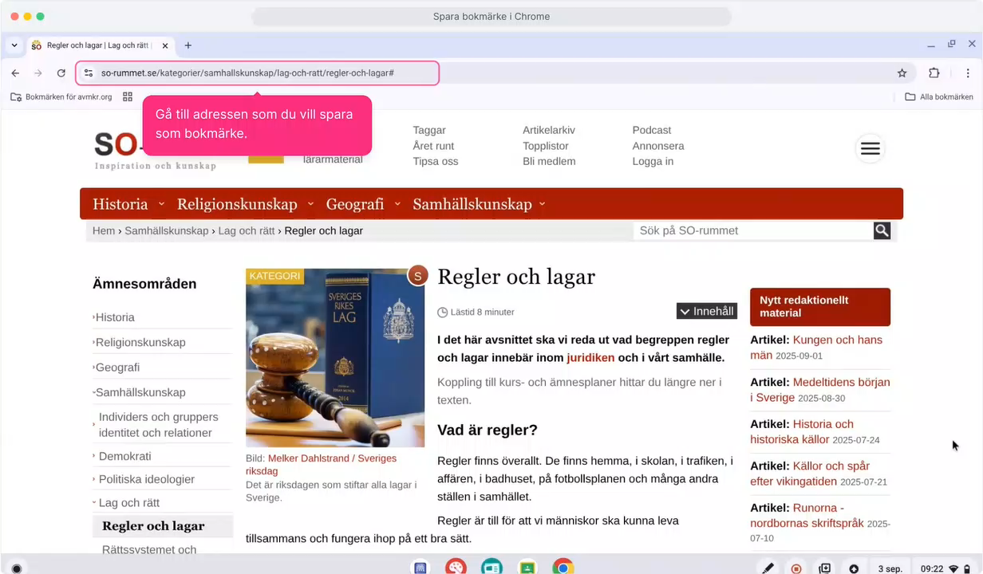
Chrome - Save Bookmark
Organize
More manuals can be found at Organizing presentations and manuals
Focus

Slide 26
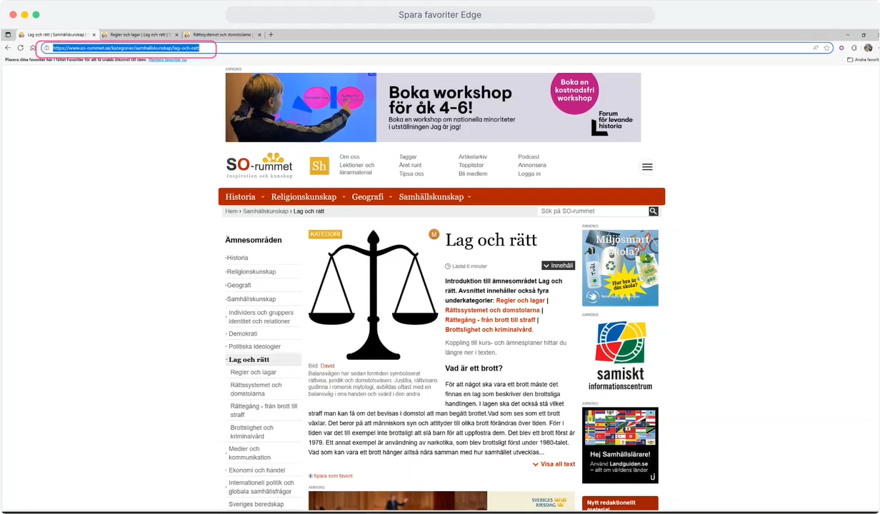
Edge - save favorite
Organize
More manuals can be found at Organizing presentations and manuals
Focus

Slide 27
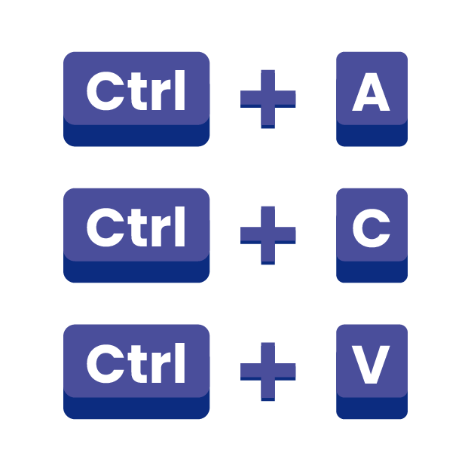
Keyboard shortcuts
Organize
Focus

Slide 28

Keyboard shortcuts
You press several keys at the same time to quickly do something, such as copy text/image (Ctrl + C) or paste (Ctrl + V).
"Ctrl + C" means that you hold down the Ctrl key together with the C key (copy).
Keyboard shortcuts can be used in
Web browser
Various programs, such as word processors
Chromebook and PC (Mac)
Keyboard shortcut Ctrl + C
Organize
Focus

Slide 29
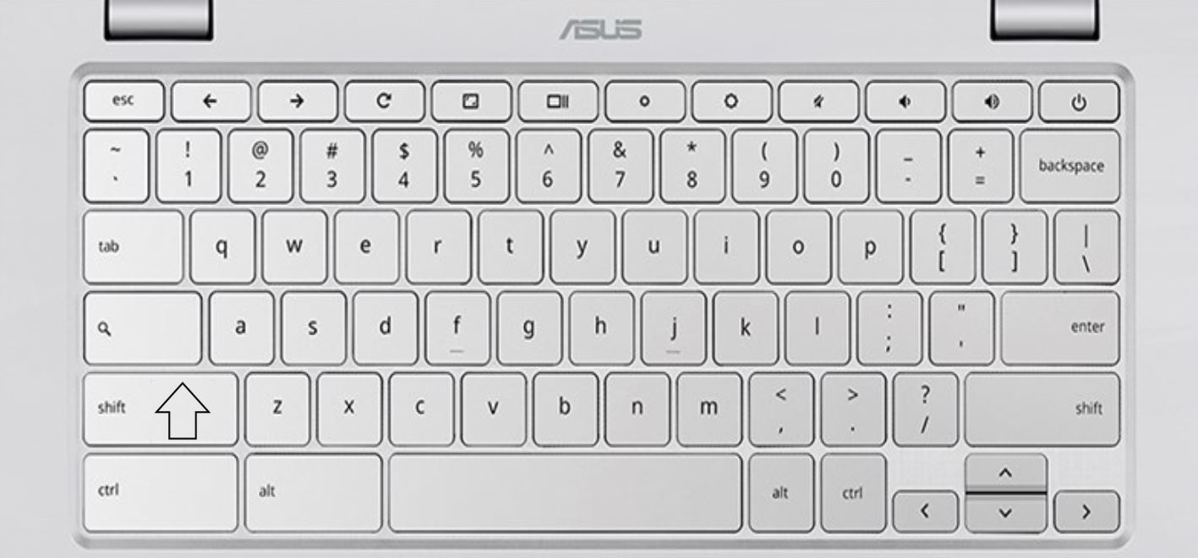
Keyboard Chromebook
The keyboard shortcut keys:
View window
Search your Chromebook or the web
Shift
Control - abbreviated ctrl
Everything
Organize
Focus

Slide 30
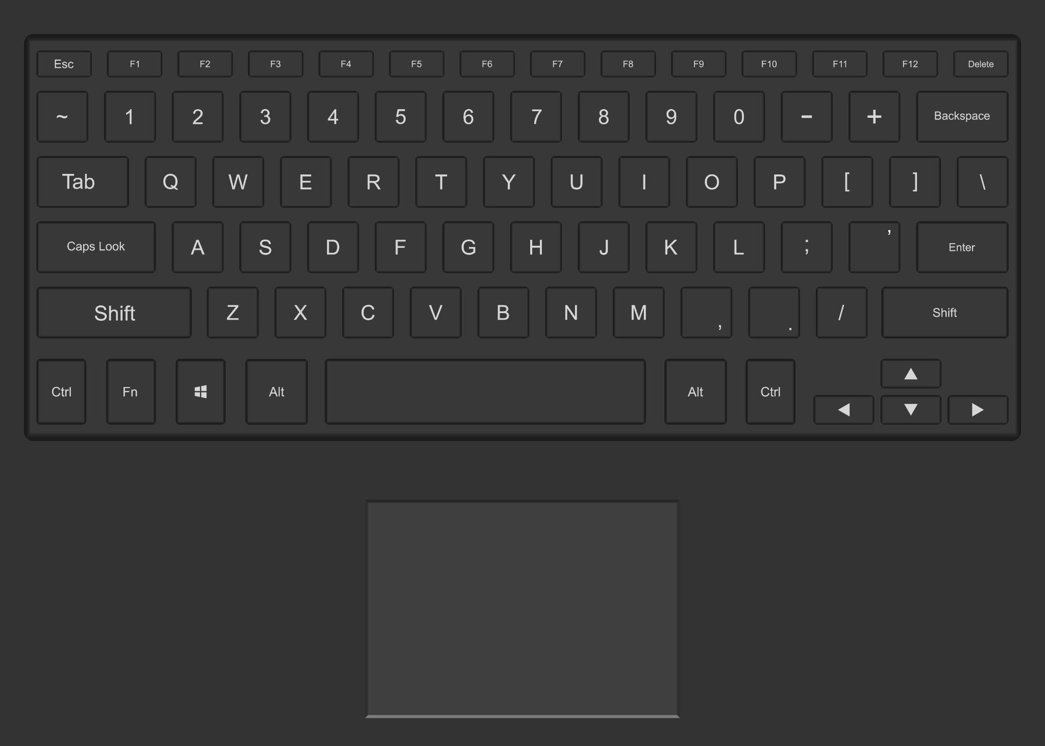
Keyboard PC
The keyboard shortcut keys:
Shift
Windows-tangenten
Everything
Control - abbreviated ctrl
Organize
Focus

Slide 31
Task - test keyboard shortcuts
Chrome /Edge browser
Open new tab | Ctrl + T
Close tab | Ctrl + W
Switch between tabs | Ctrl + Tab
Open last closed tab | Ctrl + Shift + T
Refresh the webpage | F5 for windows Ctrl + R for chromebook
Zooma in/ut | Ctrl + + / –
Search by webpage | Ctrl + F
Tell each other about your best keyboard shortcuts!
Organize
For more keyboard shortcuts, see Organize keyboard shortcuts
Focus

Slide 32
Task - test keyboard shortcuts
Multitasking
 | Windows | Chromebook
Switch between open programs/windows | Alt + Tab | Alt + Tab
Show the desktop (minimize everything) | Windows + D | Shift + Alt + M
View all open windows (overview mode) | – | Show Window button (above the 6th)
Windows-tangenten
Show the Window key
Organize
For more keyboard shortcuts, see Organize keyboard shortcuts
Focus

