Slide 1

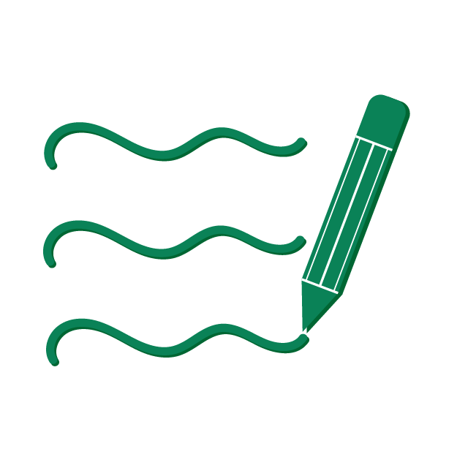

Digital Study Techniques - Notes
Notes help you:
  Listen better
  remember more and study smarter.
You don't have to write everything – the important thing is that you write in your own words so you understand.
Notes
Focus

Slide 2

How to stay focused
Film: 2 min 07 sec
Notes
Link to video: How to stay focused
Focus
Notes:
Do you recognize yourself in losing concentration in class or when you do your homework?
Here are some tips to reduce the risk of starting to think about other things!
When you learn something new, try to associate it with knowledge you already have. If you read about a historical event, connect it to other things you know about that time. Think about what it looked like, what you wore or what happened in other places in the world. By putting the information in context, it becomes easier to understand and remember.

Slide 3
How to stay focused
Stay focused and become more active:
Create your own images in your head of the content
Reflect on the content
Take notes
Notes
Focus

Slide 4
Take notes by hand or digitally?
Take notes by hand
Take notes digitally
Improves memory
No notifications to disturb
You write in your own words – it increases understanding
Easier to draw your own symbols/images
Easy to organize and search
Easy to share with others
Insert images, videos, and links
Easy to edit/modify
Notes are accessible from multiple devices
Notes
Focus

Slide 5
Questions
How do you prefer to take notes?
(paper and pen or digital)
Talk to a friend and discuss the pros and cons of the different methods.
Notes
Focus

Slide 6
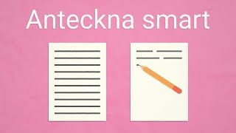
Take smart notes
Film: 1 min 28 sec
Notes
Link to video: Take smart notes - how to get more out of the lesson
Focus
Notes:
Notes help you remember what is said in class and what you read as you study. But there is no one right way to take notes. Try out what suits you best and you are guaranteed to benefit from it!

Slide 7
Take smart notes
Take smart notes
Write summaries after each longer paragraph
Go through the notes after class/study time
Write down your notes
Find your own way to take notes!
Notes
Focus

Slide 8


The Cornell Method
Notes
Focus

Slide 9
The Cornell Method
Annotation method
Structured way of taking notes and organizing
Focus and remember better
Notes
Focus

Slide 10
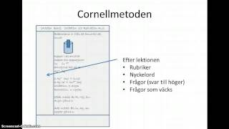
The Film Cornell Method
Film: 5 min 15 sec
Notes
Link to the film: The Cornell Method
Focus

Slide 11
The Cornell Method
1.
Date/subject/lesson
Divide the paper into four fields
Date, Subject, Lesson
Note area
Reminders
Summary
2.
Note area
3.
Reminders
4.
Summary
Notes
Link to manual The Cornell Method: The Cornell Method
Focus

Slide 12
The Cornell Method
1.
22/8 Photosynthesis
For example:
2.
Photosynthesis
Carbon dioxide (CO₂)
Water (H₂O)
Solar energy
Chlorophyll
Sugar/Glucose
What does the plant need to be able to do photosynthesis?
Photosynthesis= plants make food with the help of the sun
They take in CO₂ (carbon dioxide) from the air
They suck up H₂O (water) from the soil
The sun provides energy
The leaves contain chlorophyll (green dye)
The plant makes sugar (food) + O₂ (oxygen)
Sugar = plant food
O₂ is released → we breathe it in
1. Date, Subject, Lesson
2. Take notes during class;
Bulleted Form Abbreviations
3.
3. After the lesson; keywords,
Questions
4. After class;
Summary, what do you have
learned
4.
Photosynthesis is when plants make their own food using sunlight, carbon dioxide, and water. They form sugar that they use as energy, and release oxygen that we humans breathe in.
Notes
Link to manual The Cornell Method: The Cornell Method

Slide 13
Task
Practice the Cornell Method
Notes
Link to manual The Cornell Method: The Cornell Method
Focus

Slide 14

Google keep
Notes
Focus

Slide 15
Notes- Google Keep
Note-taking tools from Google
Digital post-it notes
In Google Keep, you can:
Writing To-Do Lists
Take notes
Set reminders
Save text/articles/links from the web
Organize your notes using labels
Share notes with others and collaborate
View saved notes directly in the side menu of Google Docs
https://keep.google.com/
Notes
Link to manual Google Keep: Google Keep
Focus

Slide 16
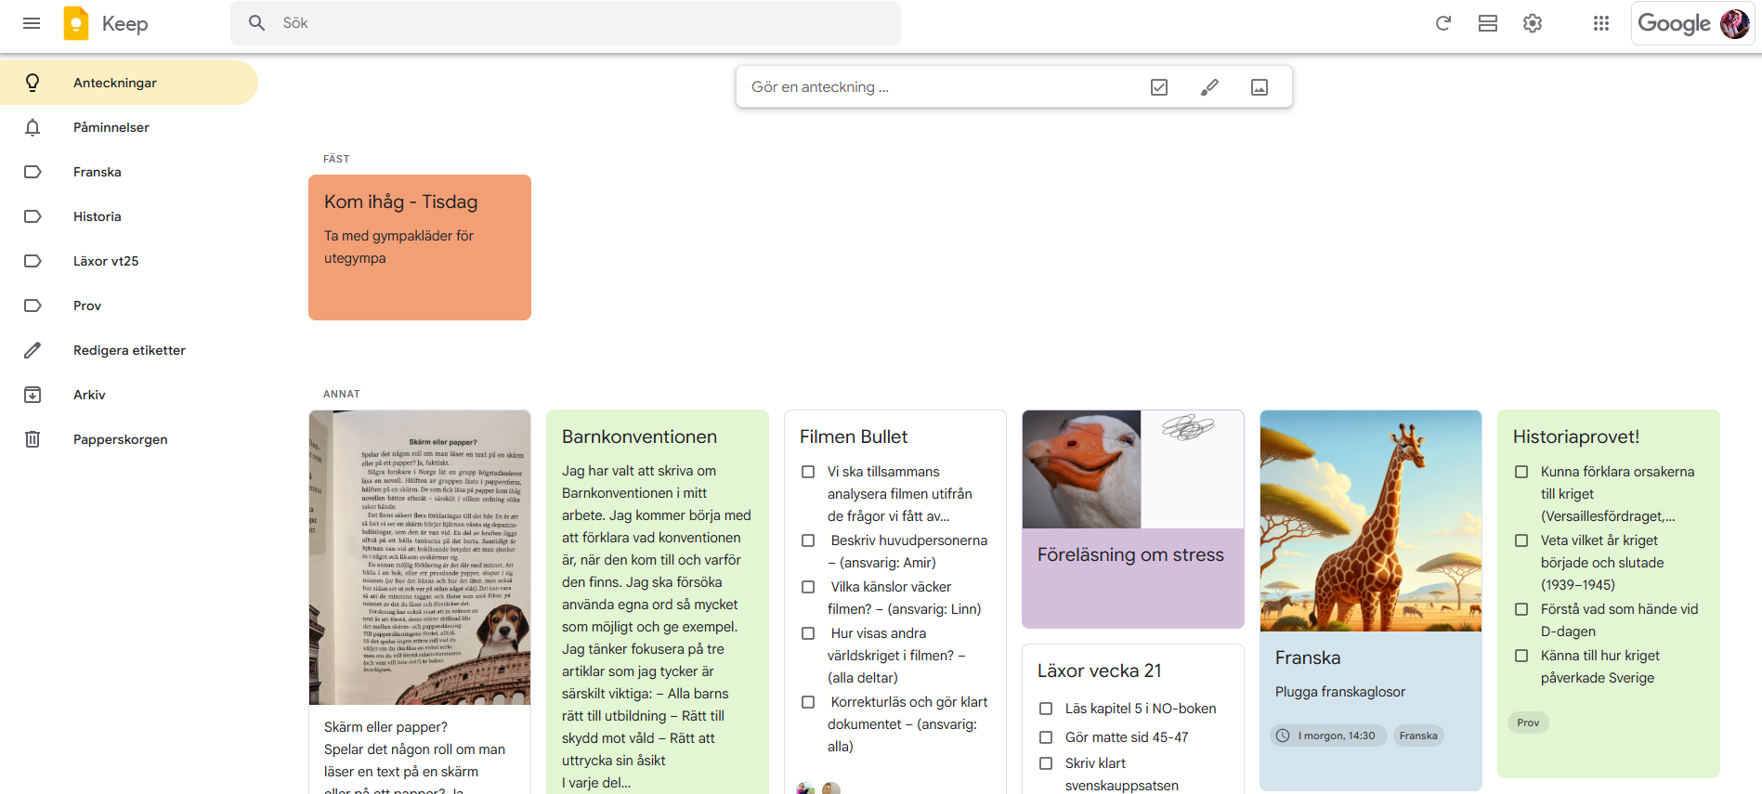
Notes- Google Keep
4.
3.
View and settings
Create new note
2.
Summary area for notes
Side panel with labels
1.
Notes
Link to manual Google Keep: Google Keep
Focus

